Slide 1
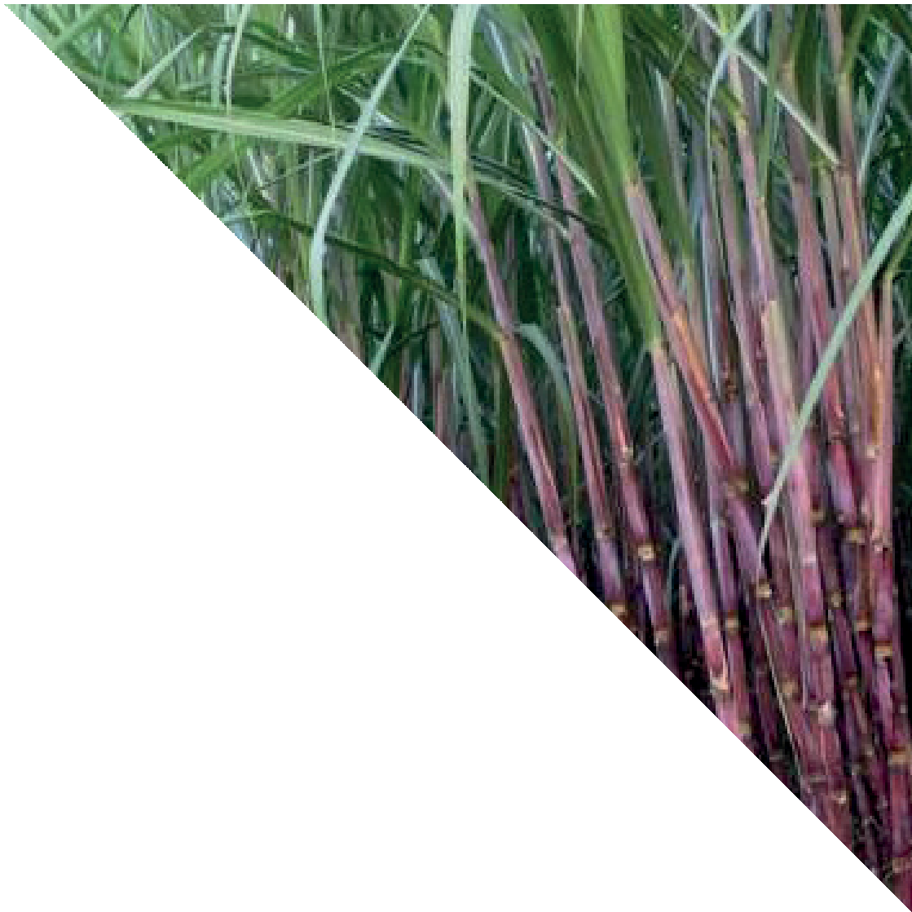
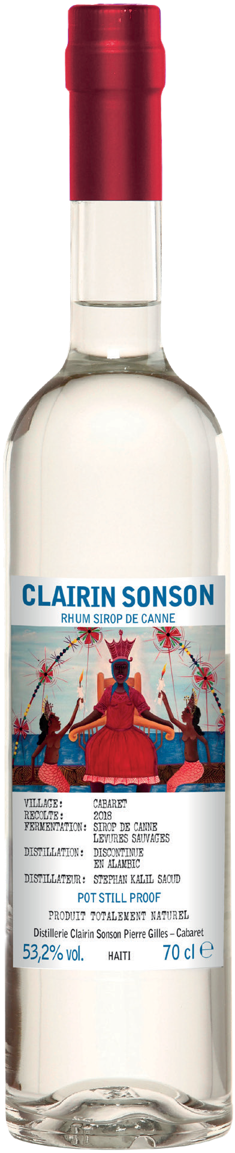


CLAIRIN SAJOUS
70CL | 53.2% |
THE SPIRIT OF HAITI
Clairin Sajous is created in St-Michel d’Attalaye, by cane grower and distiller Michel Sajous at hiChelo Distillery. Clairin, meaning ‘clear’ in Creole, is a subcategory of rum, which is usually made from fresh sugar cane juice.
TRADITIONAL PRODUCTION
Clairin has been produced the same
way in Haiti for centuries. Clairin Sajous is made using the free run juice from biodynamic Cristallane sugar cane, which is naturally fermented with wild yeast which contributes to the unique flavours from this specific location.
HERBACEOUS FLAVOUR WITH HINTS OF TROPICAL FRUIT AND CHOCOLATE
Clairin Sajous has notes of cinnamon, tarragon, overripe bananas and squishy apples to start. Darker notes develop, with hints of liquorice and dark chocolate joined by even more green herbs
DIRECT-FIRED POT STILL
There are over 500 small distilleries producing Clairin across Haiti. Michel uses an ancestral direct-fired 200ltr pot still to double distilled Clairin Sajous which brings a richness of texture to the liquid. The spirit is then bottled without dilution or any additions.
HERBY AND EXOTIC WITH NOTES OF MANGO AND PINEAPPLE, BEST SIPPED NEAT
One for the rum explorer, this Clairin is best sipped neat or over ice so that its complex flavour can be appreciated. It will also add a new dimension to your favourite classic rum cocktail.

