Slide 1
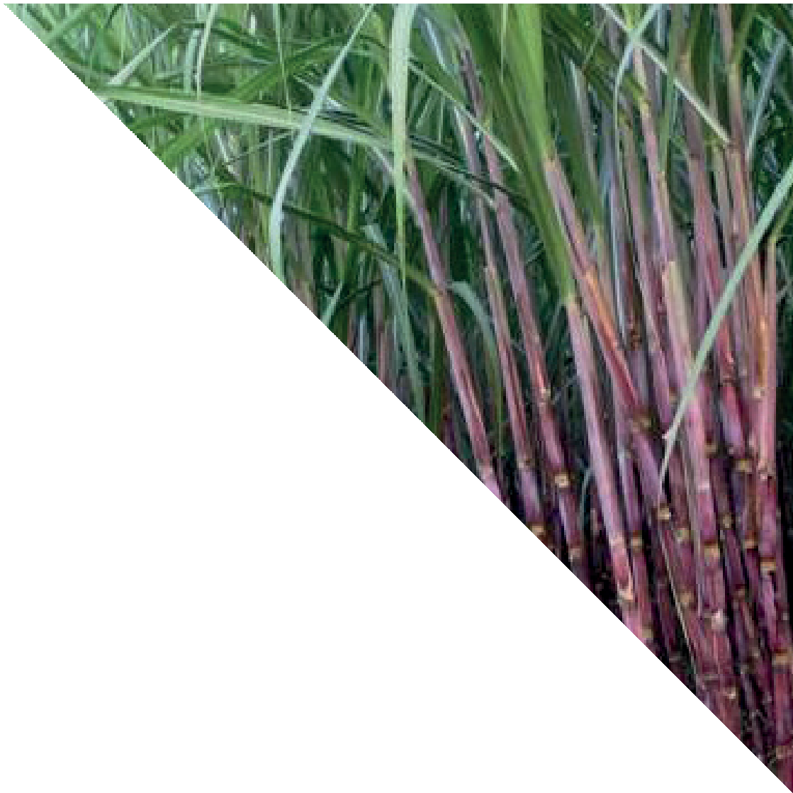
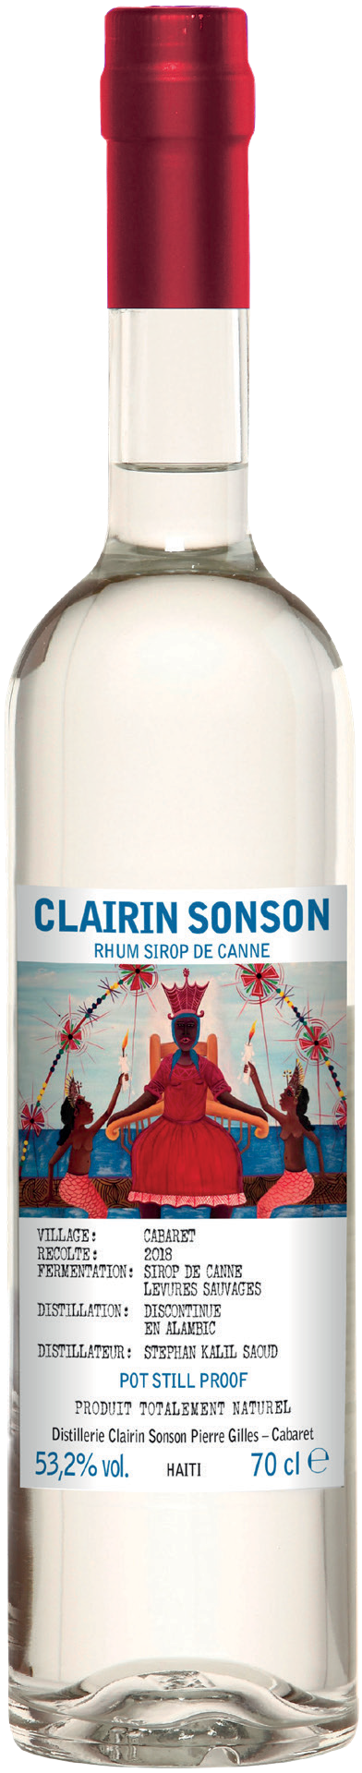


CLAIRIN SONSON
70CL | 53.2% | £53.00
THE SPIRIT OF HAITI
Clairin Sonson is created in Cabaret, Haiti, by cane grower and distiller Stephan Kalil Saoud. Clairin, meaning ‘clear’ in Creole, is a subcategory of rum, which is usually made from fresh sugar cane juice.
TRADITIONAL PRODUCTION
Clairin has been produced the same
way in Haiti for centuries. Clairin Sonson is made using the syrup from biodynamic Madame Meuze sugar cane, which is naturally fermented with wild yeast which contributes to the unique flavours from this specific location.
HERBACEOUS FLAVOUR WITH HINTS OF FRUIT AND LIQUORICE
Clairin Sonson has an elegant aroma of cut grass, basil and lemongrass. On the palate, tropical fruit notes emerge with fresh cane juice, ginger, sweet pepper and liquorice.
DIRECT-FIRED POT STILL
There are over 500 small distilleries producing Clairin across Haiti. Stephan Kalil Saoud uses an ancestral direct-fired pot still to single distill Clairin Sonson which brings a richness of texture to the liquid. The spirit is then bottled without dilution or any additions.
WOODY AND EXOTIC WITH NOTES OF GRAPEFRUIT AND PINEAPPLE, BEST SIPPED NEAT
One for the rum explorer, this Clairin is best sipped neat or over ice so that its complex flavour can be appreciated. It will also add a new dimension to your favourite classic rum cocktail.

