Slide 1
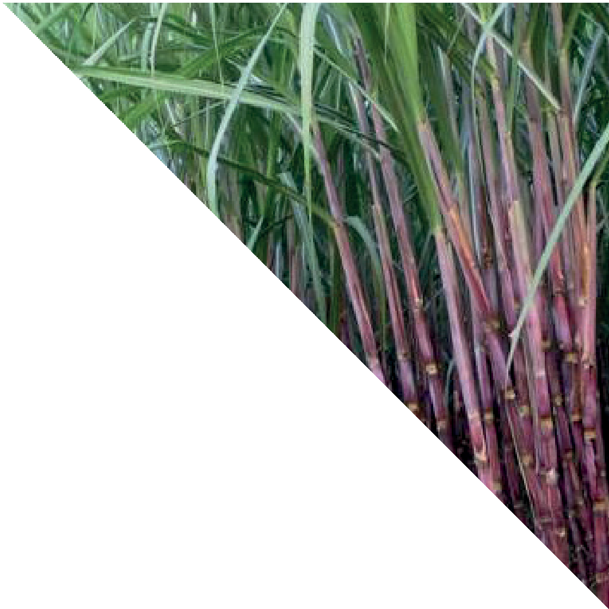
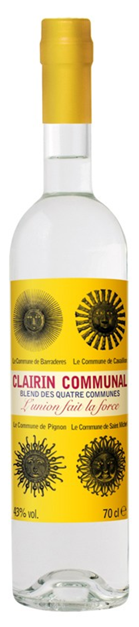


CLAIRIN COMMUNAL
70CL | 43% |
NATURAL REFLECTION OF TRUE RUM
Clairin is not only 100% Organic, it’s also 100% Natural. No Pesticides and other chemicals - The varieties of cane used in Haiti vary from region to region, and they are still chosen for their aromatic characteristics and not for productivity and yield.
HERBACEOUS FLAVOUR WITH HINTS OF FRUIT AND PEPPER
It has an incredible perfume with notes of pear tree blossom, fresh sugar cane juice and almonds. The palate is seductive and vibrant with pear, nectarine and a hint of white pepper and green chillies
THE SPIRIT OF HAITI
A blend of Clairin’s from producers Sajous, Vaval, Casimir and Le Rocher, Communal showcases the spirit of Haiti, with the rich aromas and complex profiles of each of the four producers coming together beautifully in this harmonious blend.
TRADITIONAL PRODUCTION
Clairin has been produced the same
way in Haiti for centuries. Each of these Clairin producers have their very own distinctive character from their use of wild indigenous canes and terroir, which and are celebrated in this bottling location.
IDEAL FOR MIXING OR ENJOYED SIPPED NEAT
One for the rum explorer, this Clairin is best sipped neat or over ice so that its complex flavour can be appreciated. It will also add a new dimension to your favourite classic rum cocktail especially a Daiquiri.

